Slide 1

Conference for
FOOD PROTECTION
Promoting Food Safety
Through Collaboration

Slide 2
CFP Provides a Forum for Individuals who have an Interest in Retail Food Safety
The CFP is devoted to:
  Identifying emerging problems related to retail food safety.
  Formulating solutions to food safety problems that are based on sound science.
  Developing, implementing and/or revising recommended food safety practices as needed to promote food safety and consumer protection.
  Achieving consensus among constituent groups on food safety issues.
    Requires more than a simple majority opinion.

Slide 3
History of The Conference for Food Protection
1971 - First Conference Meeting in Denver, CO
Sponsored by the Food and Drug Administration and the American Public Health Association.
Participants representing industry, government and consumers focused on microbiological aspects of food safety.
1984 - Second Conference in Washington, D.C.
Focused on toxicological and microbiological concerns.
A Constitution was adopted to provide structure and process for the organization.
1986 - Third Conference in Ann Arbor, MI
Agreed to focus on retail food safety issues and hold Conference meetings every two years.

Slide 4
CFP Governance
Constitution and Bylaws
Biennial Meeting/Conference Procedures Manual
Biennial Meeting/Information Manual
CFP Policies
  Antitrust policy – prevents antitrust violations
  Commercialism – prohibits CFP from endorsing a product process or service by brand name.
  Late Issue Submission – allows an Issue to be submitted after the deadline for a late-breaking food safety matter.
  Open Meeting – all meetings are open to all members and the public.
  Record Retention – records are retained electronically unless otherwise determined by the Executive Director
ALL documents are available on the CFP website

Slide 5
CFP Constitution and Bylaws
Formalizes the objectives of the Conference.
Establishes the organization and operation of the Conference.
Establishes categories of membership.
Created the Executive Board to manage the affairs of the Conference.
Provides professional staff to support the Conference.
Establishes rules for the CFP biennial meeting and the Assembly of State Delegates.

Slide 6

CFP Objectives
Focus on retail food issues and programs.
Seek food safety solutions through collaboration of food regulatory agencies, the food industry, consumer groups, and academia.
Identify/address problems that affect retail food safety from farm to table.
Promote science as the basis for food safety regulations.
Propose regulations that will be accepted by regulators and industry alike.
Disseminate information about food safety.

Slide 7
CFP Organization
Executive Board
Council I
Council II
Council III
Assembly of State Delegates

Slide 8
Conference for Food Protection
Member Constituent/Stakeholder Groups
    Regulators – Federal, State, Local, and District/Territory
    Industry – Food Service, Retail Food, Food Processing, Vending and Distribution, and Food Industry Support
    Academia
    Consumers
CFP
Regulators
Food Industry
Academia
Consumers

Slide 9
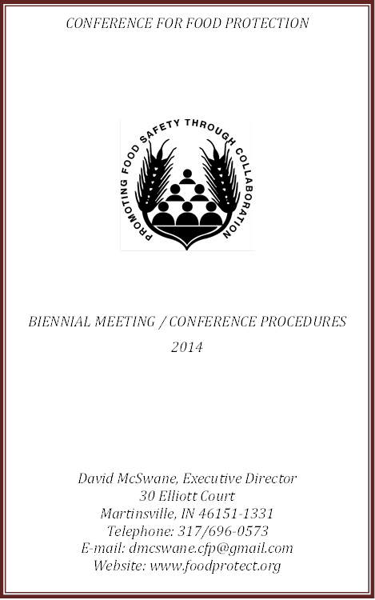
Biennial Meeting/ Conference Procedures
Supplements the CFP Constitution and Bylaws in the conduct of the biennial meeting and other Conference business.

Slide 10
The CFP Process
Issue Submission.
Council Deliberation and Decision.
Assembly of State Delegates Vote on Recommendations from the Councils.
CFP Recommendations forwarded to FDA/USDA/CDC or other relevant party.
CFP Executive Board Manages Process.
Ongoing Committee Formation/Work.

Slide 11
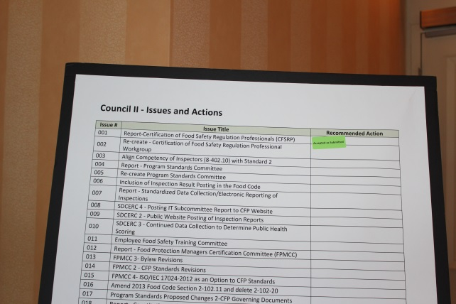
Issue Submission
Anyone may submit an Issue.
Many Issues arise out of CFP committee work.
An Issue Submission Form must be accurately completed and include a “Recommended Solution” to identified problems.
The CFP Issue Committee reviews each issue that is submitted and, when accepted, assigns the Issue to a Council for deliberation.

Slide 12
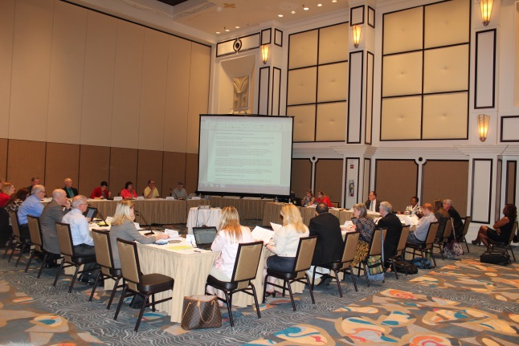
CFP Council Structure
Council I – Laws and Regulations
Council II – Administration, Education and Certification
Council III – Science and Technology
Each Council consists of 22 members.
    An equal number of regulatory and industry members is provided on all Councils.
    Council III can have up to 10 at-large members to assure expertise in science and technology.
    Federal agencies may provide a non-voting consultant for each council.
Participation in CFP Biennial Conference Meetings and Committee work increases a member’s chance of being selected for a Council.

Slide 13
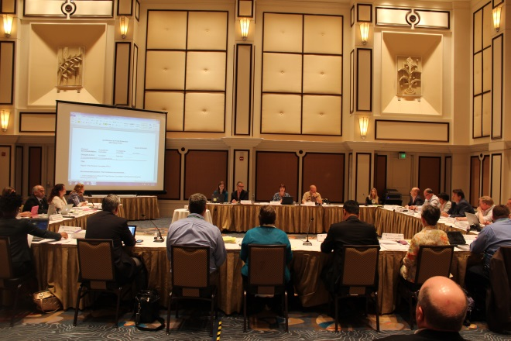
CFP Council Process
Issues accepted by the Issue Committee are assigned to the most appropriate Council.
    An issue may be referred by one Council to another if deemed appropriate.
    Council deliberations follow Robert’s Rules of Order.
Any Conference member may provide testimony on an issue to a Council.

Slide 14
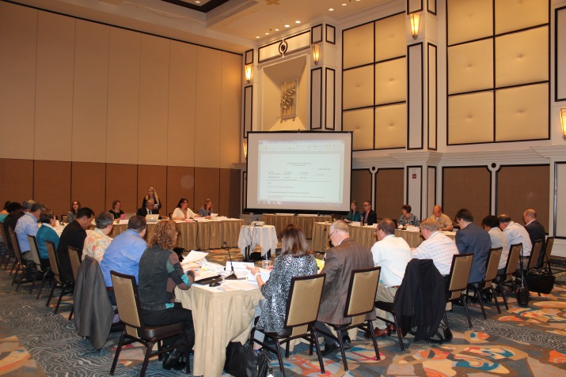
CFP Council Process
A Council may take the following actions on an Issue:
  Accepted as Written.
  Accepted as Amended.
  Take No Action.
  (a reason for recommending no action must be provided)
All Issues move to Assembly of State Delegates for consideration.

Slide 15
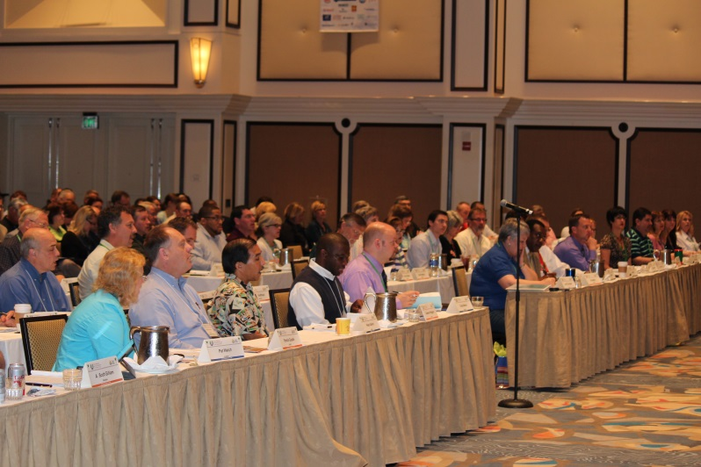
Assembly of State Delegates and Final Disposition of Issues
Each State has one vote (a vote may be shared between Agriculture and Health).
Delegates vote to accept or reject Council recommendations on Issues.
Delegates may vote on Issues in groups or extract Issues for further discussion.
Council recommendations cannot be changed.

Slide 16
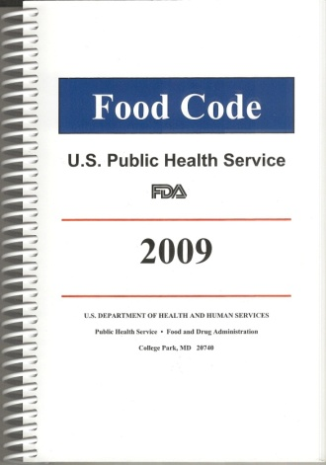
Assembly of State Delegates and Final Disposition of Issues
State Delegates may refer an Issue to the Executive Board for consideration.
Issues accepted by State Delegates are formally presented to Federal Agencies with request, in FDA’s case, to include in the next edition of the Food Code.

Slide 17
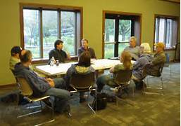
CFP Committees
Much of the work of the Conference is done by ad hoc and standing committees between biennial conference meetings.
Committees work under the direction of Council Chairs and the Executive Board.
Committees are formed to work on Issues that arise out of the Conference and are assigned to Councils or the Executive Board.

Slide 18
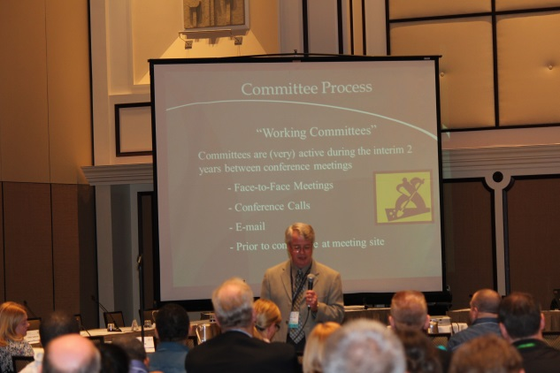
CFP Committees
Only CFP members may join a committee.
Appointments to committees are made to ensure balanced representation of stakeholder groups.
Most committee work is carried out via conference call and email.
Committees present findings/recommendations at the next Biennial Conference meeting by submitting Issues that include a Final Committee Report and Recommendations from the group.

Slide 19
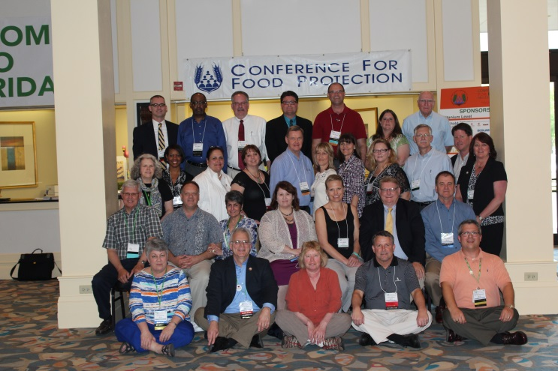
The Executive Board
Provides Administrative
Management of the Conference
23 Voting Members
Federal (3), State (6) & Local (6) Regulatory Agencies (geographically distributed)
Industry (6)
Consumers (1)
Academia (1)
13 Non-Voting Members
Past Conference Chair
Program, Issue, and Constitution & Bylaws Chairs
Executive Director, Treasurer, and Assistant
Council Chairs (3) and Vice chairs (3)

Slide 20
Consensus/Caucus Meetings
Five Consensus/Caucus Groups
  1. Local Regulators
  2. State Regulators
  3. Consumers
  4. Industry
  5. Academia
Will meet 3 times during Conference to:
  Discuss issues.
  Elect members to the Executive Board for 6-year terms.

Slide 21
Become a CFP Member and Participate in the Organization’s Activities
  Observe - all meetings are open (except for Caucus).
  Briefly Comment on Issues.
  Ask questions.
  Network.
  Join Committees and Councils and work on Issues to extend participation.

Slide 22
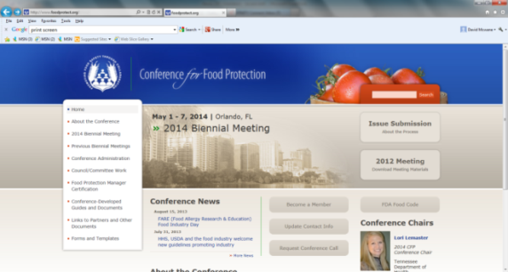
Learn More about CFP
Visit the CFP Website at www.foodprotect.org
  Membership Information
  Mission and Objectives
  Conference History
  CFP Constitution and Bylaws
  CFP Conference Procedures
  Past/Future Conference Meetings
  Issue Submission Process
  Committee Progress Reports
  Executive Board Meeting Minutes
  Current News Section
  Check in often to stay informed

Slide 23
We Encourage You to Become a Member of the
Conference for Food Protection
??? Questions ???
Feel free to contact the CFP Staff at dmcswane.cfp@gmail.com

